Slide 1
Net Zero Emissions Target
25th August 2022

Slide 2
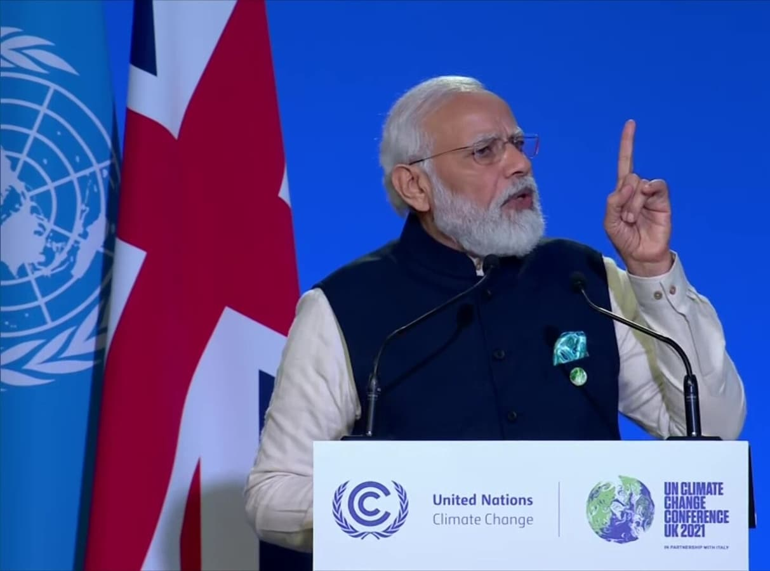
India’s climate commitment at COP26, Glasgow (Panchamrit)
1
Enhance non-fossil fuel energy capacity to 500 GW by 2030
2
Meet 50% of energy requirements from renewable energy by 2030
3
Reduce projected carbon emissions by 1 billion tonnes from now onwards till 2030
4
Reduce carbon intensity of economy by less than 45% by 2030 (base year 2005)
Hon’ble PM Shri Narendra Modi at the COP 26 Meet in Glasgow
5
Achieve Net Zero emissions by 2070
Notes:
Installed capacity – 396 GW (Thermal – 236 GW / RE – 106 / Hydro – 46 / Nuclear – 7)
India Emission 2020: 2.7 Billion tons of CO2e (Energy emission – 2.3 billion tons)
GHG Gases - Carbon dioxide (CO₂), Methane (CH₄), Nitrous oxide (N₂O), Hydrofluorocarbons (HFCs), Perfluorocarbons (PFCs), Sulfur hexafluoride (SF₆), Nitrogen trifluoride (NF₃)

Slide 3
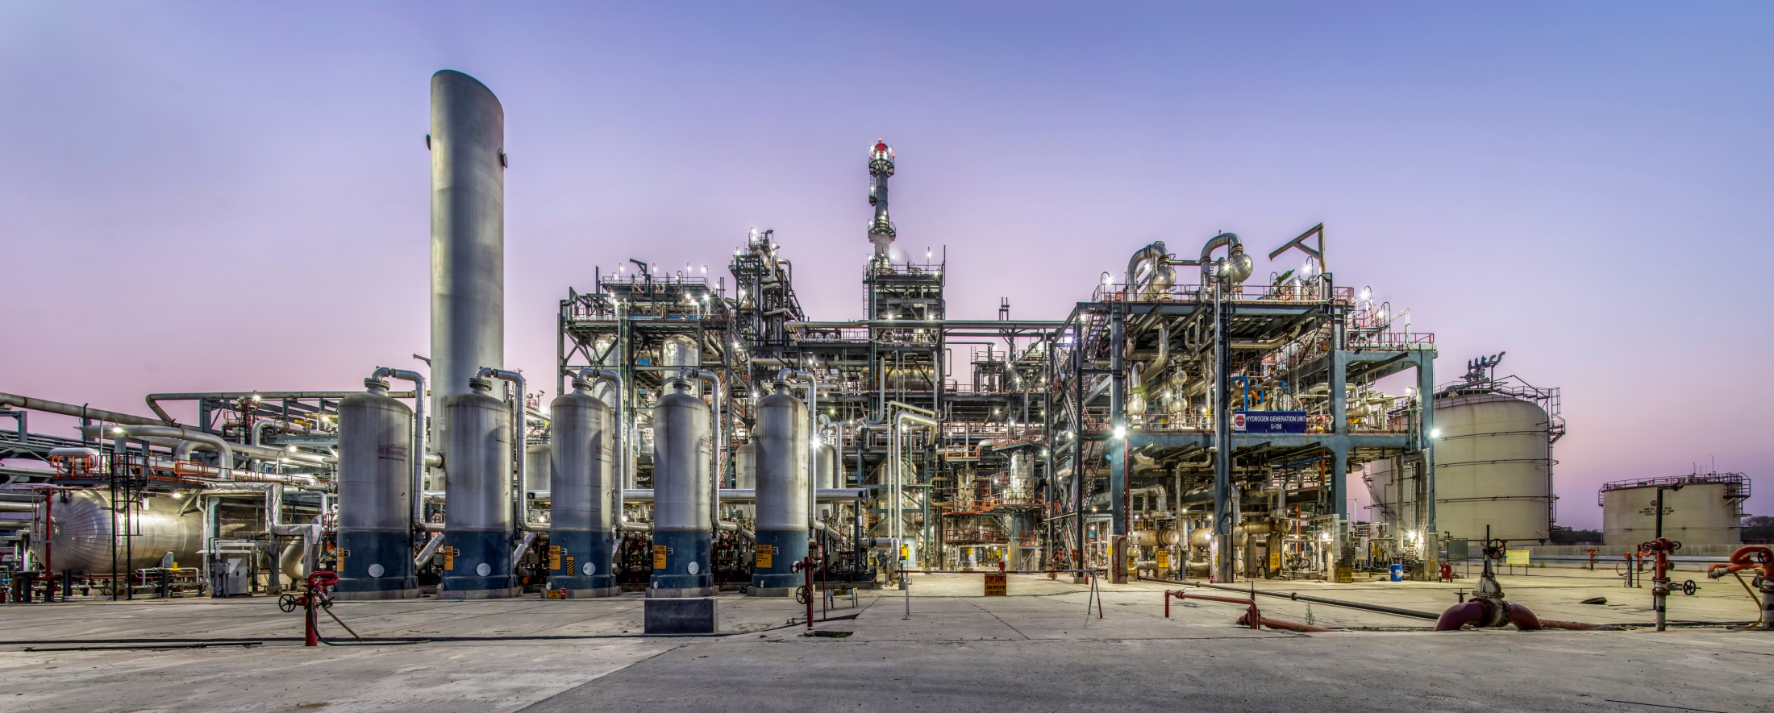
Emissions being targeted for Net Zero
Scope-1 Emissions
GHG emissions from assets and activities that fall within organizational boundary.
Scope-2 Emissions
GHG emissions on account of purchased electricity consumed in operations.

Slide 4
GHG Emissions (Scope-1 & 2) Standalone Performance in FY 2021-22
Parameter | Unit | Operations
 |  | Refinery + Petrochemicals | Pipeline Transport | Product Storage / Blending
Scope-1 Emission | MMTCO₂e | 20.67 | 0.10 | 0.05
Scope-2 Emission | MMTCO₂e | 0.24 | 0.27 | 0.21
Operational Emission (Total) | MMTCO₂e | 20.91 | 0.37 | 0.26
IndianOil Emission (Standalone) | MMTCO₂e | 21.54
% Contribution to Emissions | % | 97% | 2% | 1%
Emission incl. CPCL, Chennai | MMTCO₂e | 24.40

Slide 5
GHG Emission Projection Annual Numbers
Current Emissions
(A)
Emission from Expansion
Projects (B)
Total Emission
(C) = (A) + (B)
23.53 MMTCO₂e
Scope-1 Emission
10.75 MMTCO₂e
Scope-1 Emission
34.28 MMTCO₂e
Scope-1 Emission
Refinery & Petrochemicals*
0.24 MMTCO₂e
Scope-2 Emission
5.09 MMTCO₂e
Scope-2 Emission
>97%
5.33 MMTCO₂e
Scope-2 Emission
0.63 MMTCO₂e
Marketing, Pipelines, R&D and BD: Scope 1&2
0.20 MMTCO₂e
Marketing, Pipelines, R&D and BD: Scope 1 + 2
0.83 MMTCO₂e
Marketing, Pipelines, R&D and BD: Scope 1+2
Other Divisions
24.40 MMTCO₂e
Total Emission
16.04 MMTCO₂e
Total Emission
40.44 MMTCO₂e
Total Emission
* Data includes CPCL Emission

Slide 6
Emission Mitigation (FY 2021-22)
S. No. | Initiative | Emission Mitigation / Avoidance (MMTCO₂e)
1. | Use of Natural Gas instead of Liquid Fuels | 1.60
2. | Pipelines Transportation of crude / fuels (75% emission reduction as compared to rail) | 1.13
3. | Renewable Energy of ~240 MW (Solar: ~70 MW; Wind: ~170 MW) | 0.28
4. | Energy Conservation Projects in refineries Savings of 67,000 SRFT | 0.22
5. | Emission Offset Estimated ~40 lakh surviving plantations within & beyond boundary | 0.08
6. | LEDs installed across the company (~8 lakh nos.) | 0.05
TOTAL |  | 3.36

Slide 7
Commitments towards NET ZERO Reducing Operational Emissions
Mitigate Scope-1 & 2 emissions across our wholly owned domestic assets, on an absolute basis, by the year 2046.
Wheels in Motion…
In pursuit of this ambition, we are undertaking measures such as energy efficiency, low carbon fuel switch, renewable energy, shift to grid power, nature-based solutions and CCUS.
Energy Efficiency
Natural Gas
Green Hydrogen
CCUS
Energy audits / efficiency projects are undertaken to reduce emissions
Increasing adoption of Natural Gas in refineries in place of liquid fuels
5 KTPA & 2 KTPA units being installed at Refineries
1500 TPD EOR Project with ONGC

Slide 8
Commitments towards NET ZERO Reducing Operational Emissions
Meeting the electricity requirements of expansion projects in refineries through renewable sources
Wheels in Motion…
Grid & RE Power
RE Power for Expansion Projects
Anticipating lower grid emissions, the company is encouraging Grid & RE Power for existing plants including Refineries
Collaboration with NTPC to source ~2.3 GW RE to meet power requirement of refinery expansion projects

Slide 9
Commitments towards NET ZERO Creating an enabling environment to support actions beyond boundary
Increase the proportion of greener fuels in the product mix being offered to consumers
Wheels in Motion…
Ethanol blending crossed 10%
100 KLPD 2G Ethanol project at Panipat
128 KLPD 3G Ethanol plant at Panipat (U/C)
CBG Plants at Hingonia (6 TPD) & Gorakhpur (25 TPD, U/C)
Waste Plastic to Fuel developed (INDEcoP2F)
2000+ EV Charging Stations (Target: 10,000/ 3 yrs)
U/C: Under Construction

Slide 10
Commitments towards NET ZERO Creating an enabling environment to support actions beyond boundary
Invest in low carbon energy technology and undertake partnerships to improve product efficiency
Rs. 577 Cr R&D expenditure (RE, Bio-energy, Fuel Cell, Greener Products etc)
Pursuing partnerships with NTPC, L&T, RE Power
Engage with value chain partners to reduce emissions across current network
Energy Efficiency / Automation / Solarisation (~20,000 nos.) in Retail Network
Phasing-out old fleet from fuel transport, switching to pipelines & inland shipping from rail / road
Bring greater linkages between employee performance & company climate targets
Establish IndianOil as a leader in environment sustainability, providing support to the nation & fellow corporates in reducing environment & climate impact

Slide 11
Net Zero Approach Activity Timelines
Short Term
(1-2 Years)
Medium Term
(2-5 Years)
Long Term
(5-10 Years)
Natural (>10 Years) Investment Cycle
Complete GHG inventory
Validation & Monitoring of Mitigation Targets vis-a-vis Plans
ENCON Schemes
Renewable Energy
ENCON Schemes
Switch to NG
Grid electricity
Tree Plantation
CCUS
Renewable Energy
Boiler / Furnace Efficiency
Grey to green hydrogen (25%)
Grid electricity
CBG
Green Hydrogen
Tree Plantation
CCUS
Renewable Energy
Improving Boiler / Furnace efficiency
Grey to green hydrogen (100%)
Maximizing grid import
Improve Distillate Yield
CBG
Green Hydrogen
Tree Plantation
CCUS
Renewable Energy

Slide 12
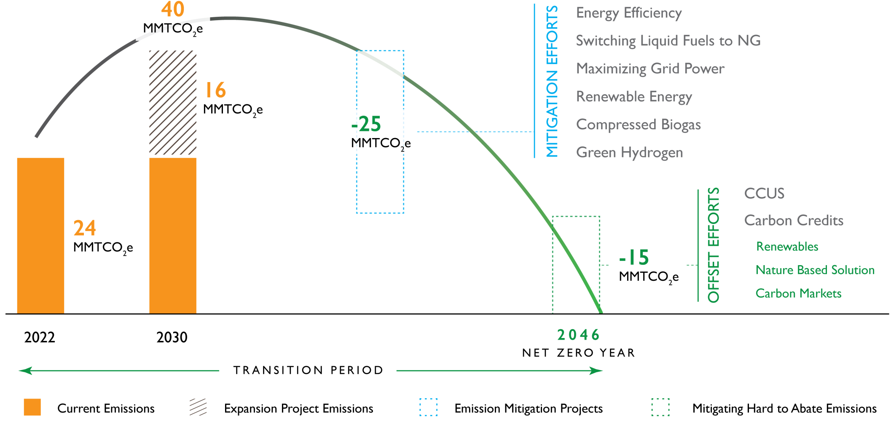
Envisaged Emission Mitigation Pathway

Slide 13
Limitation / Boundary for Net Zero
Boundary* | The target is set for 100% of operational emissions from IndianOil business units, namely refineries, petrochemicals, pipeline transportation and storage / distribution terminals and plants, located within the geographical boundary of India. Refineries of our subsidiary, Chennai petroleum Corporation Limited (CPCL) have been included within the ambit of these net zero commitments. GHGs covered: CO₂, CH₄ and N₂O Scope-3 emissions (such as end use of products, emission from product distribution and retail network) are also excluded from current net zero boundary.
* Emissions currently exclude BOO projects, retail network, JV Companies and overseas operations

Slide 14
2046
ACHIEVE NET ZERO OPERATIONAL EMISSIONS

Slide 15
Thank You

